Slide 1



in support of
Earth Day Datathon
Kick off:
Sat. April 23st, 9am - 10am PST
Presentations:
Sun.. April 24th, 4pm - 5pm PST
virtual
with generous support from

Slide 2
#datathon Agenda
Welcome
Overview of Data for Good
What to expect at a Datathon
Business problem
Overview of the data
Analysis Tips & Considerations

Slide 3

Welcome
Notes:
Thanks to all those that were involved

Slide 4
Earth Day

Slide 5
What is dataforgood?

Slide 6


Slide 7
Introduction to
#datathon

Slide 8
#datathon timeline
#datathon kick-off
Outline business problem, review the data, and answer questions
#datathon presentations
Present your findings!
THIS WEEKEND
AFTER THE DATATHON
KICKOFF
SUNDAY @ 4PM
Analyze data & check-in
Work with your team to analyze the data, solve the business problem, and create a presentation
Report Writing
Pull all the insights together into one report

Slide 9
Agenda
Saturday
9AM PST - Kick off - 90 mins
11AM PST - (Optional) Introduction to Python Exploratory Data Analysis - Natasha Mattson - WiDS (Vancouver)
12PM PST - Q&A - 60 mins - each group at set time
1PM PST - (Optional) Introduction to Tidyverse (R) - Tyler Kolisnik (UBC PhD)
4PM PST - Check in
Sunday
1PM PST - Check in (optional)
4PM PST - Presentation & Prizes

Slide 10
Prizes
Everyone who attends the final presentations is entered to win:
Microsoft backpacks and water bottles
Gift cards available to be won for:
Best Visualization and Storytelling
Best Actionable Insights

Slide 11
#datathon
We have set-up a slack channel for the event here, feel free to post questions throughout the weekend: https://dataforgoodvancouver.slack.com/archives/C03C7FYN7UM
If you are working in a team, it is up to you & your team members to set up a method of communication (slack, email, google meet, etc.)

Slide 12
#datathon presentations
Send your presentation along with supporting materials for review by 330pm PST on Sunday April 24th to: fraser.uitdenbosch@dataforgood.ca
Keep your presentation business focused, and avoid technical details. Include assumptions & methodology as appendix content.
Time limit will be maximum 5 minutes
A sample presentation template can be found in the root folder of the link above
We will organize the presentation order and let you know Sunday morning

Slide 13
Context

Slide 14
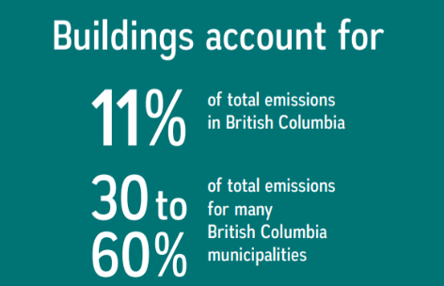
The need for carbon free homes & buildings
New Westminster and the Province of BC have outlined plans and programs to decarbonize the building sector to significantly reduce greenhouse gas (GHG) emissions.
Critical to decarbonizing BC’s building sector is Electrification which refers to the replacement of fossil fuel-based building operating systems, (such as space heating, domestic hot water, and cooking) with low carbon electric powered systems.
BC Building Electrification Road Map Final Apr2021.cdr

Slide 15
New West Climate Action Framework
CNW Council has declared a climate emergency and announced a Climate Action Budgeting Framework with the goal of moving New Westminster towards a zero carbon future by 2030.
Carbon Free Homes and Buildings Community: carbon emissions for all homes and buildings will be reduced significantly. By 2030, all new and replacement heating and hot water systems will be zero emissions.
Energy Save New West - a community energy program designed to improve the energy efficiency and reduce greenhouse gas emissions in homes and businesses in New Westminster. The program provides local residents and businesses access to energy assessments, energy upgrades and utility/government incentives.
Energy Save New West | City of New Westminster (newwestcity.ca)

Slide 16
Business
Challenge

Slide 17
Business Challenge
We want to provide actionable insights to residents about their individual climate impact and connect them with appropriate resources and programs so that they take action to reduce their energy usage.
Key Priorities for the Datathon are to:
Understand how residents are heating their homes today
Educate our residents about their energy usage and programs to reduce GHG
Establish metrics to measure and understand electricity usage
Segment customers into different groups based on energy usage
Identify factors that may drive increased electricity usage
Have a greater understanding of the effort required to increase building electrification
Where to prioritize investments in reducing emissions
Meet new people, learn something new and have fun!

Slide 18
Residential Customers
1. As we move towards increased building electrification, we would like to better understand factors that affect how our residents are using electricity today. Two key factors associated with electricity usage are the type of home and how you heat it:
Type of Home
What is the average electricity usage for different types of housing? (Single Family, Condo, Rowhouse, Apartment)
New Westminster has numerous heritage homes and building standards have changed over time. How does the age of a home relate to electricity usage?
Is there a difference in the amount of energy consumed by a Single Family Dwelling with a Basement Suite vs a Single Family Dwelling?
Home Heating & Cooling
What % of our customers are using electricity to heat their home today (inferred)?
What % of our customers are using Natural Gas?
What is the difference in electricity consumption for homes heated by fossil fuels vs electricity?
Consider using kWh used per Square Foot as a way to compare different sized homes.

Slide 19
Heat Dome
2. Between June 25 and July 1, 2021, British Columbia experienced a heat dome, a high-pressure weather system that traps heat, with record-high temperatures across the province.
How did the heat dome impact usage of electricity? By building type? By Neighbourhood?
What % of our residents do you estimate are using Air Conditioning? (e.g. significant individual Year over Year increase in electricity usage during heat wave)

Slide 20
Conservation
3. Residential customers are charged one rate for electricity up to a certain threshold in each billing period, and a higher rate for all electricity use beyond that threshold. This "stepped" rate is designed to encourage conservation. The higher rate kicks in after 1,350 kWh of usage over a two month billing period. We would like to learn more about customers who consume electricity at this higher rate.
What percentage of customers hit the 2nd rate tier and pay a higher rate for electricity?
Are some types of homes more likely to have this level of consumption?
On an annual basis, how many billing cycles do these customers typically hit the 2nd rate tier?
How many kWh do they usually exceed the threshold by?
What is the typical profile of customers and their dwellings that consistently hit the 2nd rate tier?
Is this behaviour seasonal?
Are those customers who hit the stepped threshold increasing there electricity consumption year over year? How do they compare to those who do not hit the threshold?
Does this stepped rate help with conservation?

Slide 21
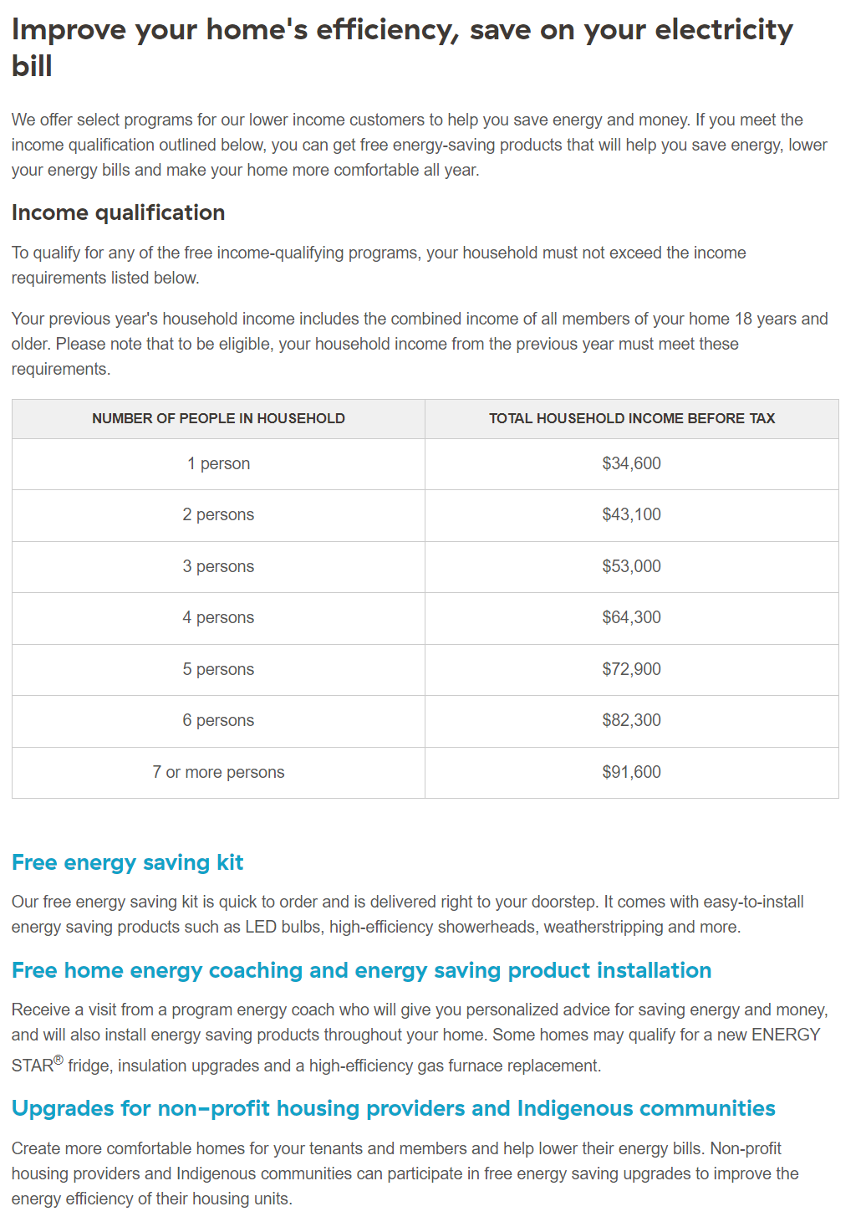
Energy Poverty
4. The City is interested in supporting low to moderate income households improve their home energy efficiency, save on their utility bill and make their home more comfortable. In partnership with BC Hydro, they are offering a Free energy saving kit (bchydro.com) to those households that qualify. Based on the acceptance criteria outlined and actual consumption, what parts of the city should we target for this program?
For some further background:
https://energypoverty.ca/backgrounder.pdf
For mapping of energy poverty in New Westminster
https://energypoverty.ca/mappingtool/
Census and Energy Poverty metrics for New Westminster Census Tracts can be found in Census and Energy Poverty

Slide 22
Electricity Consumption
6. There are a wide variety of factors that can drive up the use of electricity. Understanding more about the relationship between these drivers and consumption can inform how and where we prioritize investments and education efforts.
For example:
Building Attributes (e.g. Sqr Footage, Age of Home, Number of Kitchens etc.)
Weather/Seasonality
Demographics - Age, Number of People in the home
Income
Etc.
What factors are correlated with Electricity Consumption?
How could we segment/cluster our residential customers to inform our understanding of their consumption patterns?
What would a typical profile of a customer belonging to these segments look like?

Slide 23
How do I compare to my neighbours?
7. One way to educate our residents about their energy usage is to help them understand their electricity consumption relative to their neighbours.
For larger Condo buildings we have included the ability to link all condos at the same street address using the BuildingKey
Do similar sized units consume the same amount of electricity?
How could we present this information to residents in way that they can understand their relative consumption?
For Single Family homes, looking at various factors such as size, age and type of home etc.:
How could we use and present this information to residents in way that they can understand their relative consumption and encourage them to use less energy?
Using the EnerGuide data, can we understand the impact on……
The Apartments.txt file contains a list of 80 different rental apartment buildings where the tenants pay their own electricity bills. Apartments_Usage.txt contains all the meter readings for the tenants and the buildings over the last 3 years. How do these different buildings compare to each other?

Slide 24
What questions do you want to ask?
We’ve put forward several questions the City would like to answer.
You don’t have to limit yourself to these questions, the data sets or materials!

Slide 25
Dataset
Overview

Slide 26
Electricity Consumption - Single Family
SFD.TXT - the utility account, building attributes and usage summary
SFD_Usage.TXT - meter readings over the last 3 years (bi-monthly)
Data Dictionary.xlsx - defines the meaning of the fields in these files
Three types of dwellings considered - Condominium, Single Family Dwelling and Townhouse
Electricity Consumption is measured every 2 months for residential customers***
AccountKey - links these two files together
BuildingKey - allows you to compare condos within the same building if the building is large
CensusTract - allows for linking to Statistics Canada Census Information
If opening these files in Excel it would be good to set the keys and tract as text

Slide 27
Electricity Consumption - Apartments
80 Apartment Buildings and all units within the building that have an electrical utility account
Apartments.TXT - building attributes and usage summary for the Apartment Building
Apartments_Usage.TXT - meter readings over the last 3 years for the building and all units
Data Dictionary.xlsx - defines the meaning of the fields in these files
ApartKey - a unique identifier for each building - links two files together
If opening these files in Excel it would be good to set the keys and tract as text

Slide 28
Weather
YVR_2019_2021.csv weather data from Vancouver International Airport
3 Years of Daily Weather data
Heat Deg Days (°C) - Heating degree-days are used primarily to estimate the heating requirements of buildings.
Cool Deg Days (°C) - Cooling degree-days are used primarily to estimate the air-conditioning requirements of buildings.
May want to look at number of Heat Deg Days >0 and average Heat Deg Days (°C) to look at year over year changes

Slide 29
Energy Poverty
CUSP_Census_Energy_Poverty.csv has Census information and Energy Poverty
Energy poverty refers to the experience of households or communities that struggle to heat and cool their homes and power their lights and appliances.
Information sourced from https://energypoverty.ca/
Based on 2016 Census information
Available for all Census Tracts in New Westminster

Slide 30
Energuide
A sample of homes in the Energuide program from Metro Vancouver with a comprehensive look of energy usage in homes pre and post renovation
The data dictionary explains how to interpret the fields
Important to pay attention to measurement unit
e.g. floor space is measured in m2
The same field name with the suffix _Post is the measurement after the renovation
May provide insights about energy consumption not available in other data sets
Potential join to SFD dataset e.g. converting floor space to sq feet and year built

Slide 31
Maps
Two sets of maps for New Westminster should you wish to visualize your analysis
Neighbourhood Boundaries
Census Tracts
The following map formats are available:
Shapefiles
GeoJson

Slide 32
Data & Limitations
Electricity Usage from the City of New Westminster Electrical Utility:
Information that could identify individual account holders has been removed
Electricity Meters are read on a monthly basis for Apartments and bi-monthly for residential customers and tenants
Industrial/Commercial customers have been excluded from the data set
Electricity is measured in Kilowatt-hours
We have 3 years worth of billing information

Slide 33
Analysis Tips & Considerations

Slide 34
Electrical Utility Billing
Customer (bi) monthly kWh determination:
At the end of each billing period the customer’s meter kWh register is read. This reading is subtracted from the previous month's reading to determine kWh used during the billing period.
Meter reading errors do occur, however they are corrected during the next billing period due to subtractive meter reads. For a very simple example of a customer that uses exactly 1000 kwh per month you can see that an incorrect reading in May creates a low consumption of 950 kWh for that month The correct reading in July corrects the previous error and the customer is billed the missed 50 kWh from the previous month.
Sometimes there are negative kWh readings for larger adjustments
Month Reading kWh
Jan 0 -
Mar 1000 1000
May 1950 950
July 3000 1050
kW vs kWh
kW is the energy being used at any one moment. Example: a 1,500 Watt hair dryer uses 1.5kW while running. kWh is the energy consumption used over a period of time. Example: If you run the 1,500 Watt hair dryer for one hour it would use 1.5kWh and for 2 hours it would use 3kWh

Slide 35
Analysis considerations
Tips
Use your favorite tool!
Post your questions in Slack so everyone can see the answers
You will be surprised how quickly time passes - don’t try to answer every question
You will be surprised how quickly time passes!
Good to do some exploratory analysis to get comfortable with the data
No wrong answer - state your assumptions
Think about how an insight could be used by the City
Try to use the data to tell a story if you can
Would be great to share your work/code so we can understand your analysis better after the datathon

Slide 36
Analysis considerations & tips
Data Visualization
Keep your visualizations simple, only keep visual elements that are important in helping the viewer comprehend the information
Label clearly: give title to the graph, have legible labels, use legends wisely, label axes.
Use colors effectively: use the same colors for the same kind of data, limit the use of different colors
Avoid deceiving with your visualizations: include complete data, same scales when showing plots side-by-side

Slide 37
Questions?

Slide 38
New West Climate Action Framework
CNW Council has declared a climate emergency and announced a Climate Action Budgeting Framework with the goal of moving New Westminster towards a zero carbon future by 2030.
The City has developed 7 bold steps:
Carbon Free Corporation: The City of New Westminster will reduce its overall carbon footprint and will strive to achieve net zero carbon emissions by 2030.
Car Light Community: Accelerate the Master Transportation Plan targets for mode split: 60% of all trips within the City will be by sustainable modes of transportation (walk, transit, bike, multi-occupant shared) by 2030.
Carbon Free Homes and Buildings Community: carbon emissions for all homes and buildings will be reduced significantly. By 2030, all new and replacement heating and hot water systems will be zero emissions.
Pollution Free Vehicles: By 2030, 50% of kilometres driven by New Westminster registered vehicle owners will be by zero emissions vehicles.
Carbon Free Energy: The City of New Westminster will invest in a smart electrical grid in order to accommodate the required rapid conversion to building and vehicle electrification
Robust Urban Forest: New Westminster’s Urban Forest Canopy cover will be increased to 27% by 2030 to support the removal of 4,050 tonnes of carbon pollution every year and increase our forest’s carbon storage capacity by 50%
Quality People-Centred Public Realm: A minimum of 10% of today’s street space that currently only serves motor vehicles, excluding transit, will be reallocated for sustainable transportation or public gathering by 2030. The natural environment will be integrated with the public realm

